Slide 1
CUA REU
Week 2
Richard Lara

Slide 2
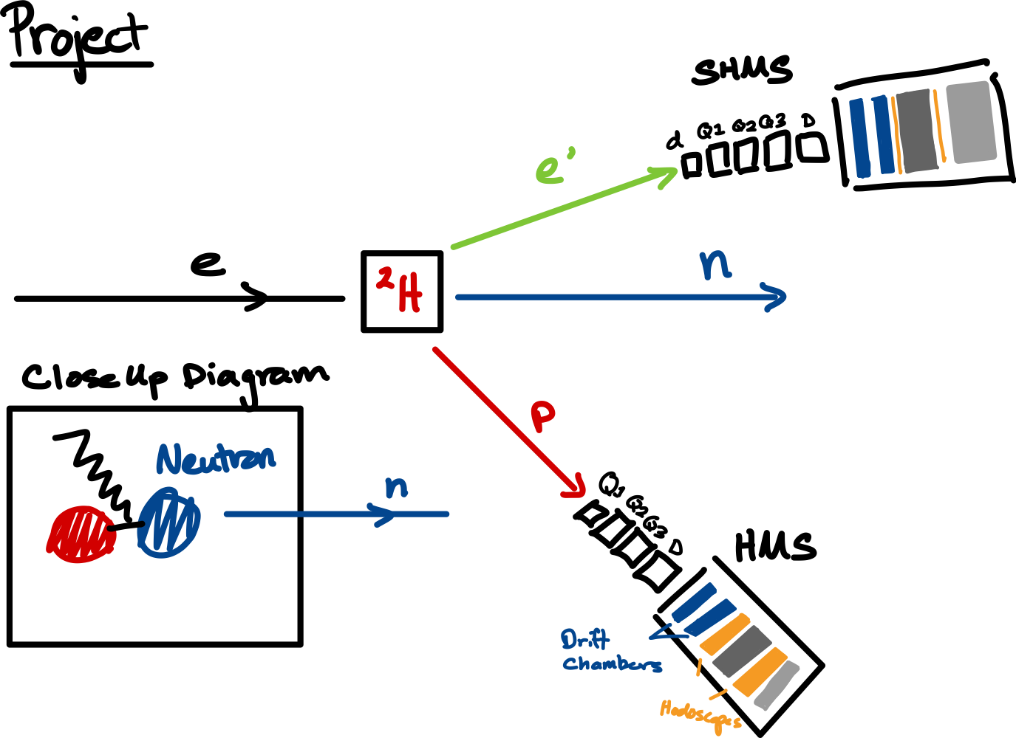
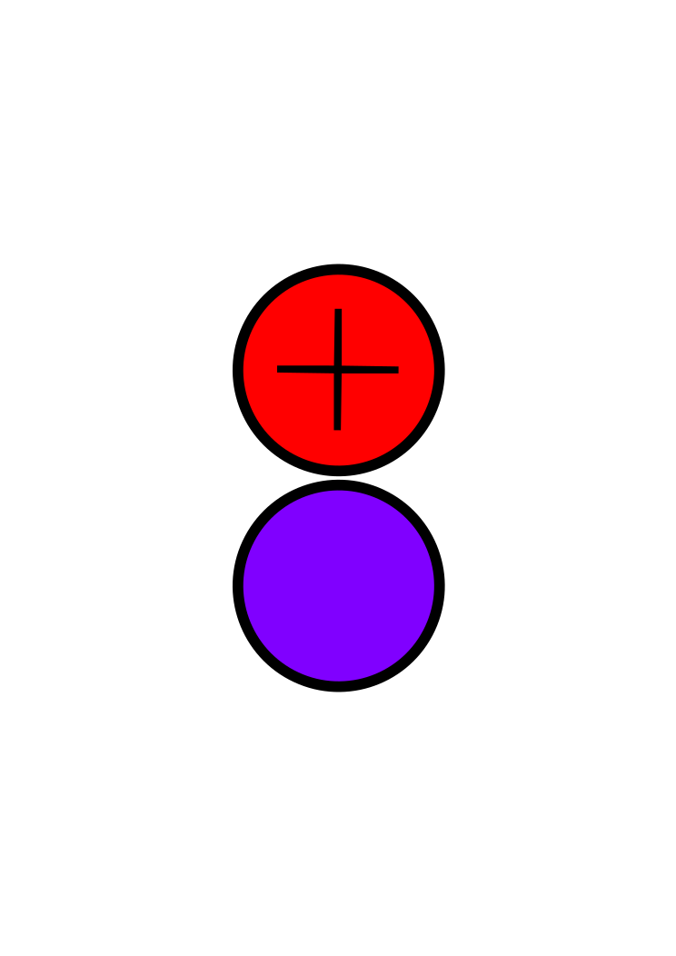
Project Overview
My project is to properly calibrate the Drift Chambers in both the Super High Momentum Spectrometers (SHMS) and HMS by utilizing the raw data files of coincidence experiments run in JLab Hall C in 2023.
***Coincidence events refer to the physics event where the scattering electron and proton of the deuteron particle is measured simultaneously by their respective spectrometer. ***

Slide 3
Why Drift Chambers?
Drift chambers are preferred in Deuteron electro-disintegration experiments for the following reasons:
Economically cheaper than alternatives (Time Projection Chambers, Silicon Detectors, Bubble Chambers, etc.)
Momentum Measurement: Important for reconstructing the kinematics of the Deuteron disintegration process
Large Area Coverage
Detects extensive number of events
High Spatial and Time Resolution
Accurately correlating events, rejecting background noise, measuring particle velocities → providing precise information for reconstructing the trajectory of particles
Compatibility with Other Detectors
Cherenkov Detectors and calorimeters used to provided information on energy measurements and particle identification

Slide 4
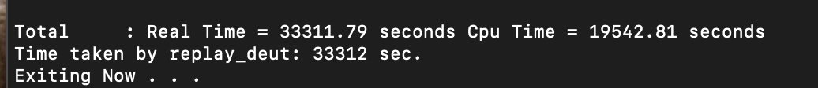
This Week’s Progress
Finalize the calibration parameters by merging all eight coincidence files into one uncalibrated root file
Calibrated the merged root file → Outputs the calibrated parameters
Using the global calibrated parameters, rerun the raw data files of the coincidence events → Outputs calibrated histograms of the following:
Calibrated Plane Drift Times, Drift Distances, and Residual Mean, Residual Sigma
Running 120, 580, 800, 900 MeV/c missing momenta raw data files to check calibration
**************************************************************************
Residual := The difference of line fit compared to a measured space-point (collection of coordinates) from the plane wires fired.
The residual measurement is used to determine the DC performance and the position of the particle tracks.
~9 hours

Slide 5
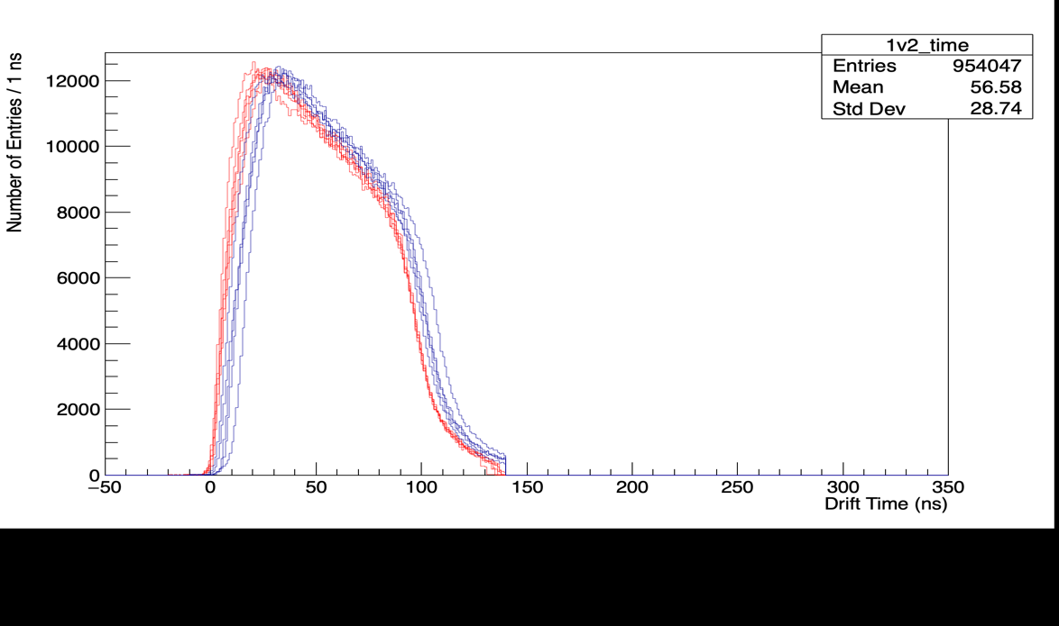
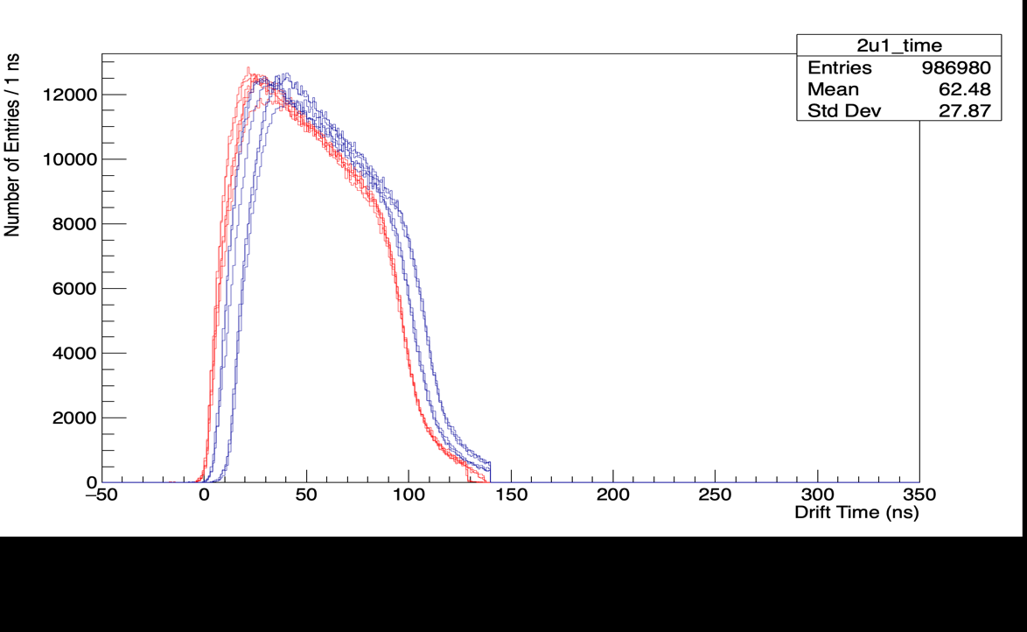
Calibration Graphs
Super High Momentum Spectrometer (SHMS) Plane Drift times
Plane 1 Plane 2
Plane1
Plane2
Legend: Corrected Drift Times
Uncorrected Drift Times

Slide 6
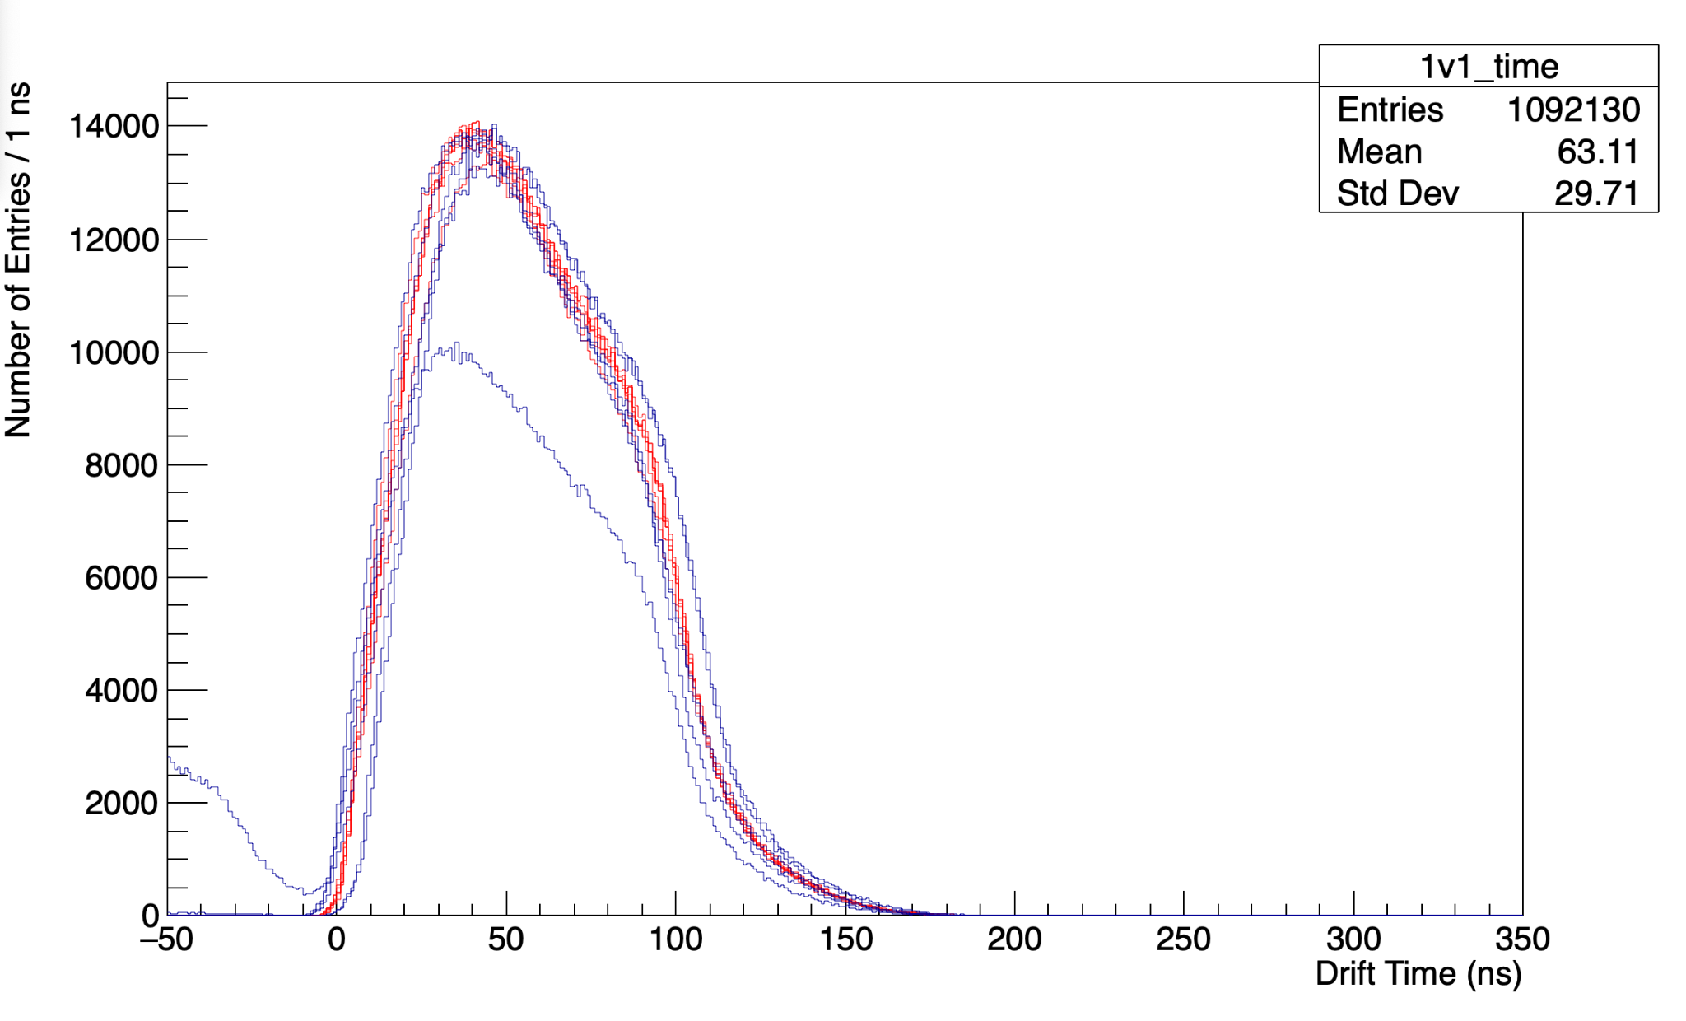
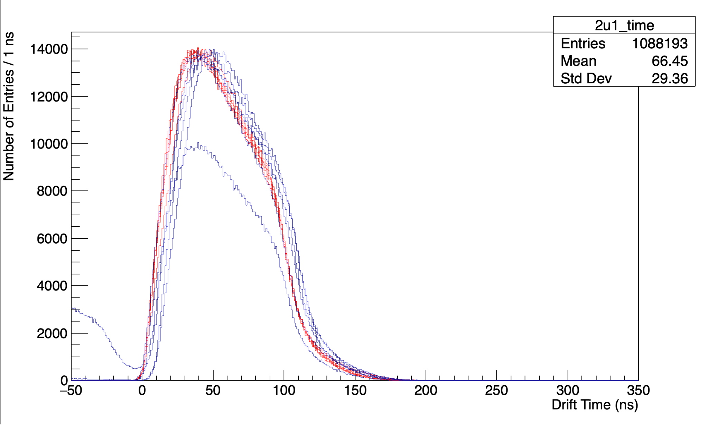
Calibration Graphs
High Momentum Spectrometer (HMS) Plane Drift times
Plane 1 Plane 2
Plane1
Plane2
Legend: Corrected Drift Times
Uncorrected Drift Times

Slide 7
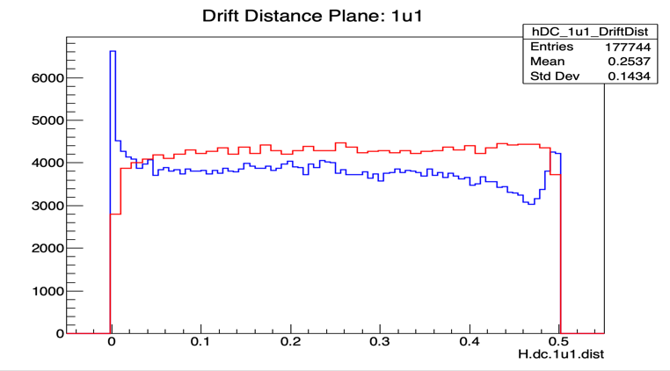
Legend: Corrected Drift Times
Uncorrected Drift Times

Slide 8
Next steps…
Check calibration parameters:
Analyze the histograms of the calibrated coincidence events
Finalize the analysis of the missing momenta histograms to check accuracy of calibration parameters

